Slide 1


Golden Snitch Team
Final Presentation
Team: Minyue Liu, Allison Xu, Ruilong Zhuang, Shumin Liu, Emma Zhou
Mentor: Tom Smith
TRANSCENDING DISCIPLINES, TRANSFORMING LIVES

Slide 2





Team Introduction
photo
photo
Allison Xu
M.S. Business Analytics
Emma Zhou
M.S. Business Analytics
Eva Liu
M.S. Business Analytics
Krystal Liu
M.S. Business Analytics
Ruilong Zhuang
M.S. Operations Research
Past Education:
B.S. & B.A. Finance
The Ohio State University
Past Career Experience:
Data Science Intern at
Biz2Credit
Equity Analyst at
Parantoux Capital
Past Education:
B.S. Finance
Rutgers University
Past Career Experience:
Data Science Intern at Changing Room
Research Assistant at Columbia Business School
Past Education:
M.S. Electrical Engineering
Columbia University
Past Career Experience:
Data Science Intern at Schlumberger
Business Analyst Intern at China Unicom
Past Education:
B.S. Statistics & Actuarial Science
UIUC
Past Career Experience:
Data Science Intern at
Biz2Credit
Actuarial Intern at
Mutual of Omaha
Past Education:
B.A. Math & CS
Whitman College
Past Career Experience:
Data Science Intern at
Otis Elevator Co.
DAAD Research Intern at OvGU
Team Introduction

Slide 3
Objective and Methodology
Project Goal
Identify main drivers behind American Airlines’, Disney’s, and PepsiCo’s stock price changes over the last 10 years
Obtain relevant public data
Implement machine learning algorithms
Project Flow
Metric
Defining
Text
Analysis
Data
Preparation
Result Analysis
Modeling
Annual Return
50 days Moving Average
Sentimental Analysis
Topic Analysis
Social Media Data
News Data
Economic data
Company Data
XGBoost
Feature Importance
Causal Inference
Data Visualization
Objective and Methodology
Notes:
Project Goal:
Obtaining relevant public data and implement machine learning models to identify key drivers behind three companies’ stock changes: American Airlines, Disney, PepsiCo from 2010 to 2021
Project Flow:
Our team starts with using annual return and 50-day moving average to define metrics, then we conduct sentimental analysis and topic analysis to figure out the public emotions and hot topics related to three companies. Next, we preprocess data including social media data, news data economic data, and company data to be ready for modeling. Then, we implement the XGBoost tree model to find out the feature importance, thus leading to the result analysis about causal inference and some corresponding data visualization.

Slide 4
Executive Summary of Findings
Model General
Across Companies
1
Various Data Sources
To identify main drivers, we examine the feature importance given by XGBoost models, data include:
Macroeconomic factors
Company Information
News
Public Opinions
2
3
4
Overall Impact Rank
The overall influence rank is as follows: (decreasing in order)
Macroeconomics
Company planning
Public opinion
Impact Differences
Among all three companies, PepsiCo and Disney are more likely to be influenced by the macroeconomic environment
Social Media Influence
More investors discuss stock market on social media (e.g., Reddit and Twitter) now compared to the earlier periods
Public opinion becomes more influential to the stock market since 2020
Executive Summary

Slide 5
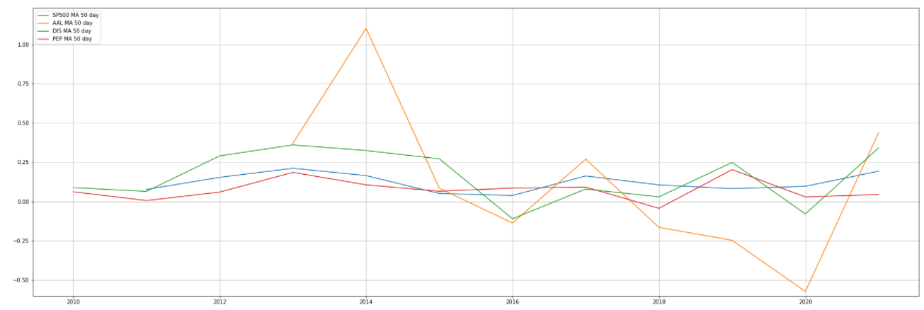
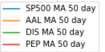
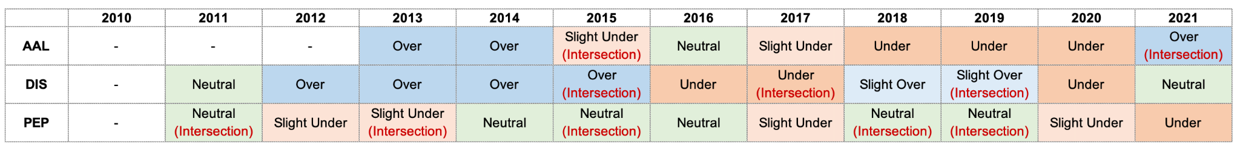

Stock Metric
Stock Performance Categorization
Time Periods Split
AAL: American Airlines
DIS: Disney
PEP: PepsiCo
50 Days Moving Average of Stock Return
Evaluated each year based on standards on the right
Grouped into similar category to split time periods for each company
Run model for each time periods to extract feature importance
Split result:
AAL: 4 periods
Disney: 4 periods
PepsiCo: 6 periods
Stock Return Compared with S&P 500
Note: Over (difference in returns > 10%); Slightly Over (5% ~ 10%); Neutral (-5% ~ 5%); Slightly Under (-10% ~ -5%); Under (< -10%)
5 | Presentation Title Presentation Title
Stock Metric
Notes:
The moving line graph indicates the 50-day moving average for the three companies compared with S&P 500 as a benchmark.
The table on the right shows our standard of defining stock performances:
For example, Over means the difference between the stock and S&P 500 is over 10%, and so on
The table on the bottom is a summary table for three companies’ stock performances based on the standard on the above table. We then split the entire 10-year time period into different several time periods for each company and conduct tree models to check feature importance.
American Airlines (AAL) has 4 time periods: 2013.12 - 2014.12; 2015.01 - 2018.12; 2019.01 - 2019.12; 2020.01 - 2021.07
Disney (DIS) has 4 time periods: 2010.01 - 2015.06; 2015.06 - 2017.06; 2017.06 - 2019.06; 2019.06 - 2021.07
PepsiCo (PEP) has 6 time periods: 2010.01 - 2011.06; 2011.06 - 2013.06; 2013.06 - 2015.06; 2015.06 - 2018.01; 2018.01 - 2019.01; 2019.01 - 2021.07
5

Slide 6
Data and Model
Model Flow - Identify Drivers of Stock Changes
News Data
Model flow within each time period for each company
CNBC
New York Times
Coherence LDA
Sentimental Analysis
Social Media Data
Macroeconomic Data¹
Final Dataset
Feature Engineering
XGBoost pipeline
Return
Twitter
Reddit
e.g., GDP Growth Rate; Exchange Rate; Inflation
Feature selection
Window method
Company Data²
Size; Value; Volatility; One-Month Momentum
Data Source: 1) Wharton Research Data Services; 2) Yahoo Finance, Wharton Research Data Services
Data and Model
Notes:
Areas of Features and Data Sources
Our team includes four aspects of data:
We got some macroeconomic variables GDP Growth Rate, Exchange Rate, Return on Bonds and Bills, Inflation, S&P 500 Index Return, and Stock Market Indexes Return from Wharton Research Data Services.
We got three classic variables when evaluating a company including size, value and momentum, along with volatility from Yahoo Finance and Wharton Research Data Services.
We got news data from CNBC and New York Times.
We got public opinions data from social media: Twitter and Reddit.
Model Flow - Identify Drivers of Stock Changes
We first conduct coherence LDA and sentimental analysis using news and social media text data, then we add quantitative financial information to form our final dataset. And we dropped highly correlated features and applied window method to establish a robust predicting model. Then, we run the XGBoost pipeline for each company in each periods (14 models in total), and get the return of feature importance for our analysis.

Slide 7
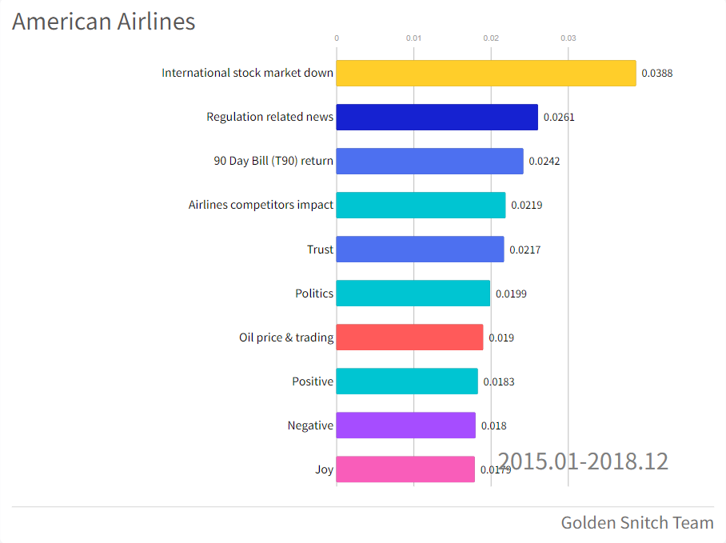
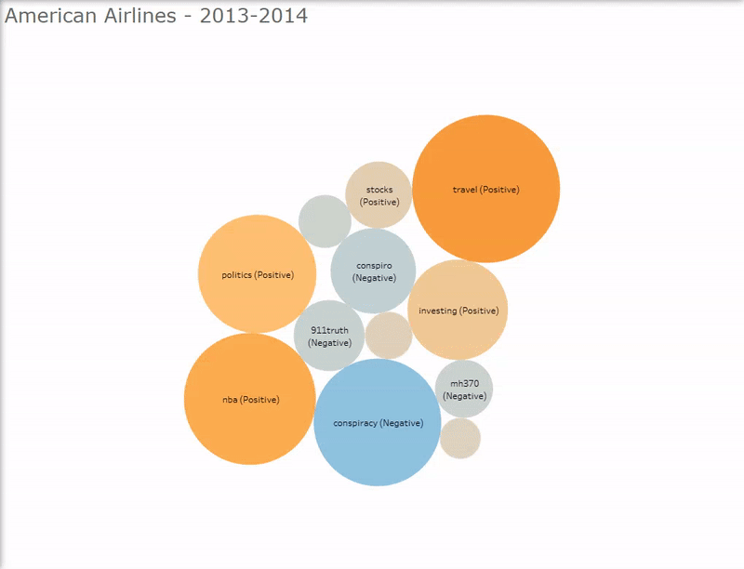
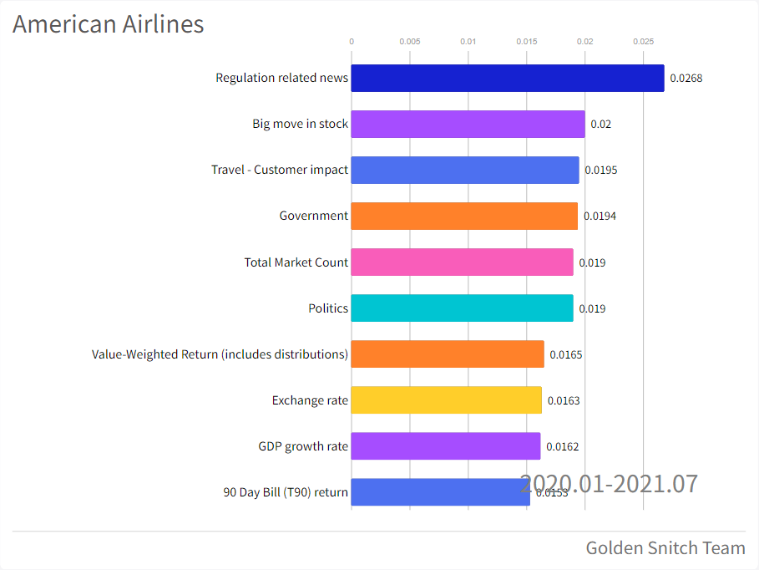
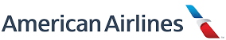
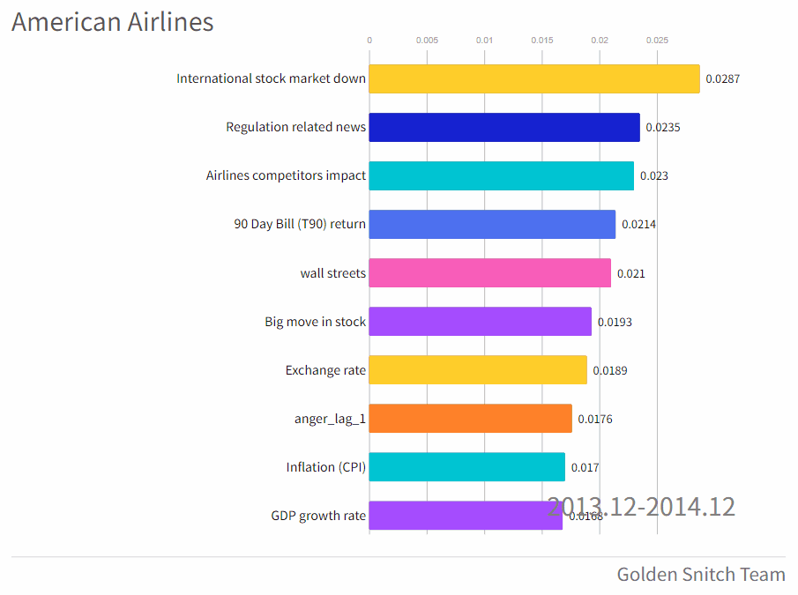

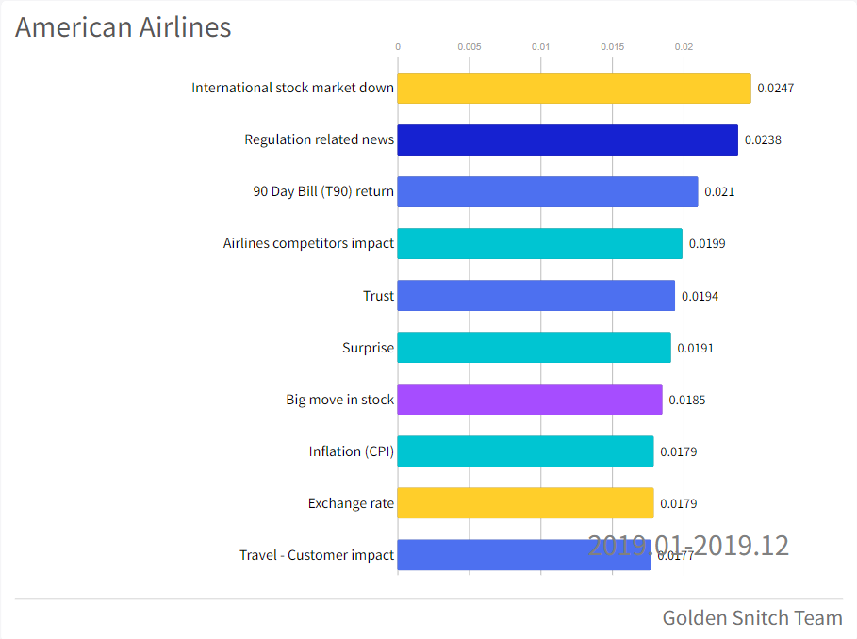
American Airlines
Findings
Airline industry is hard to restore public trust after major catastrophes
The pandemic has more direct impact on American Airline than the other two companies
American Airlines stock price is highly impacted by the international stock market
The travel bans and lockdowns immobilized customers leading to a great recession in AAL business
Source: Reddit
American Airlines

Slide 8
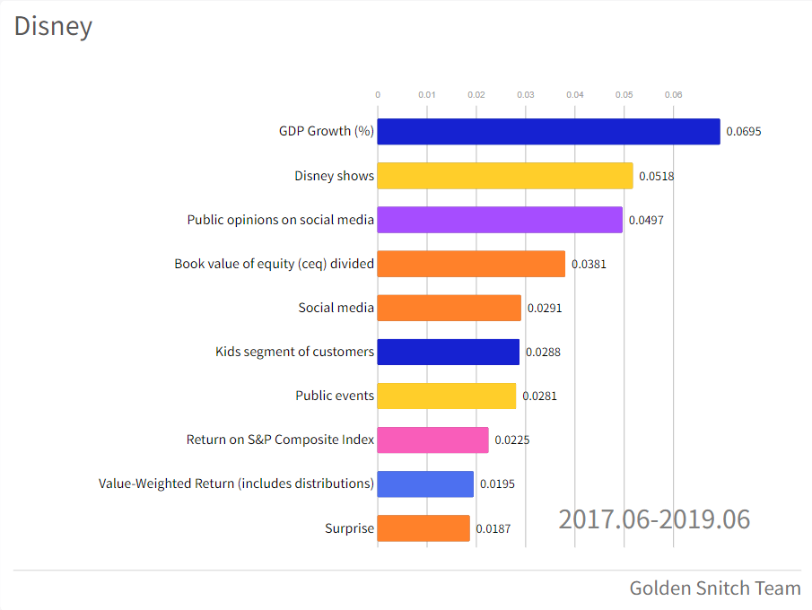
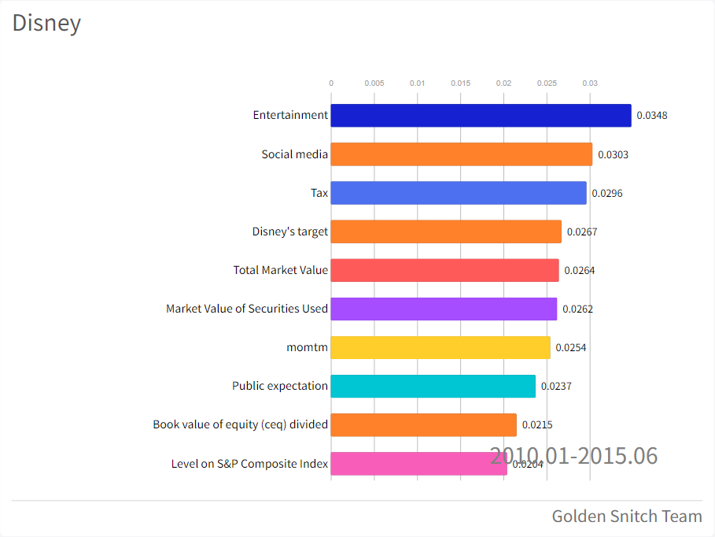
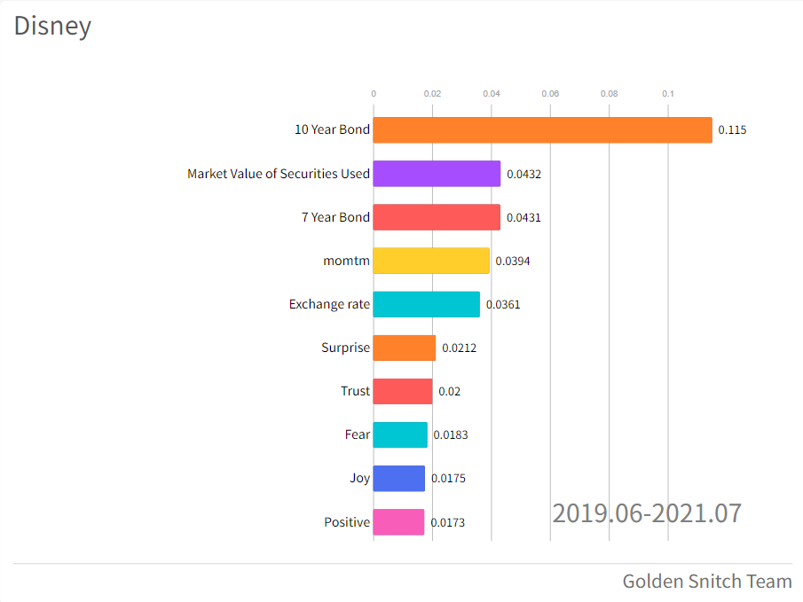
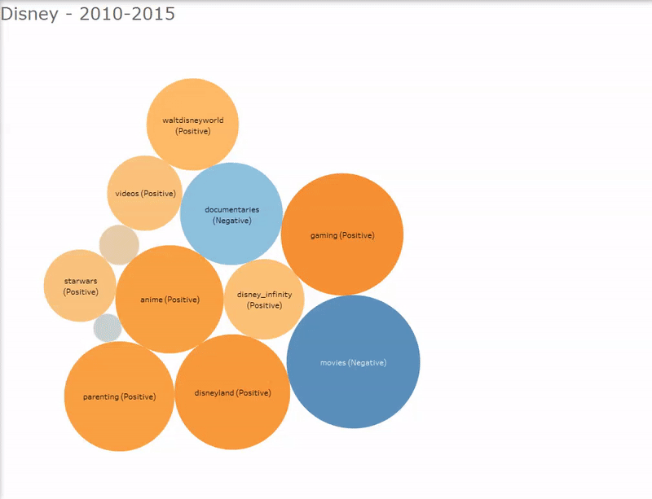

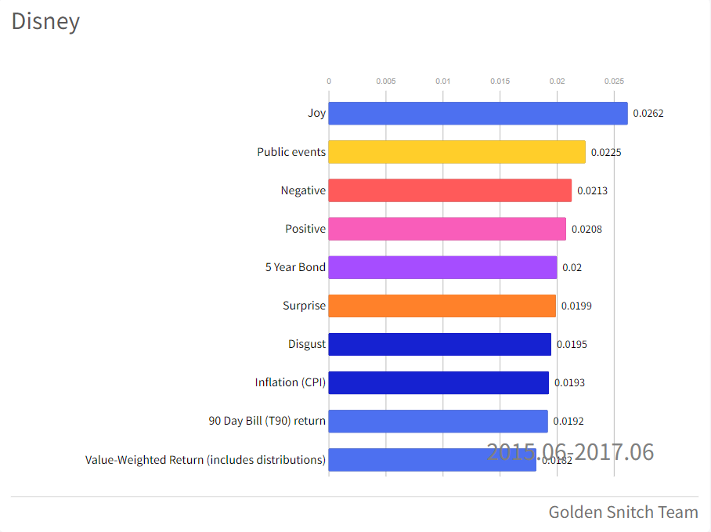

Disney
Findings
Disney’s entertainment is successful in acquiring great IPs and expanding its steaming service, bringing the public favourite content in the past 10 years
S&P index has more frequent appearances in top 10 feature importance than the other two companies, indicating market prosperity boosts cultural industry development
Source: Reddit
Disney

Slide 9
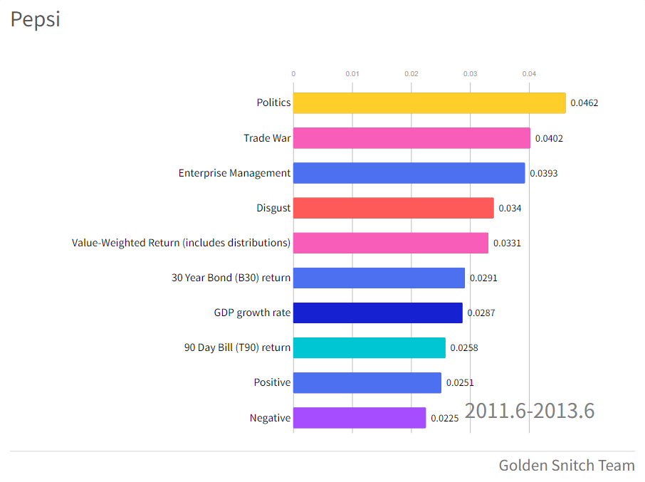
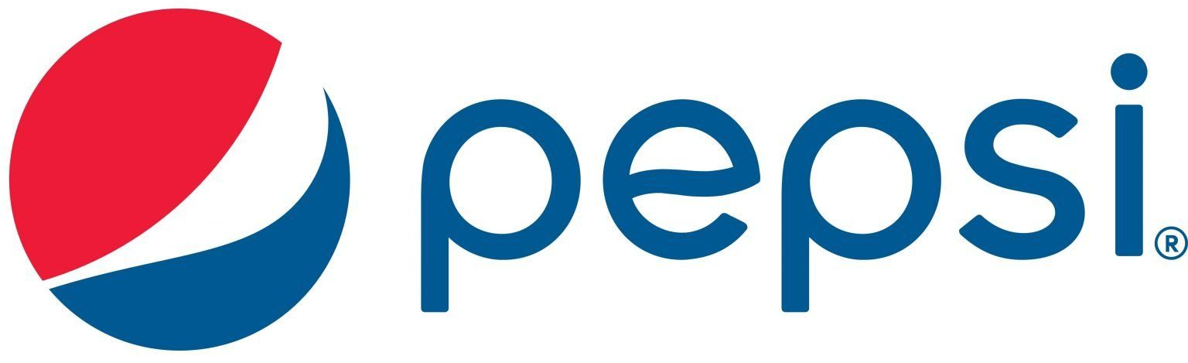
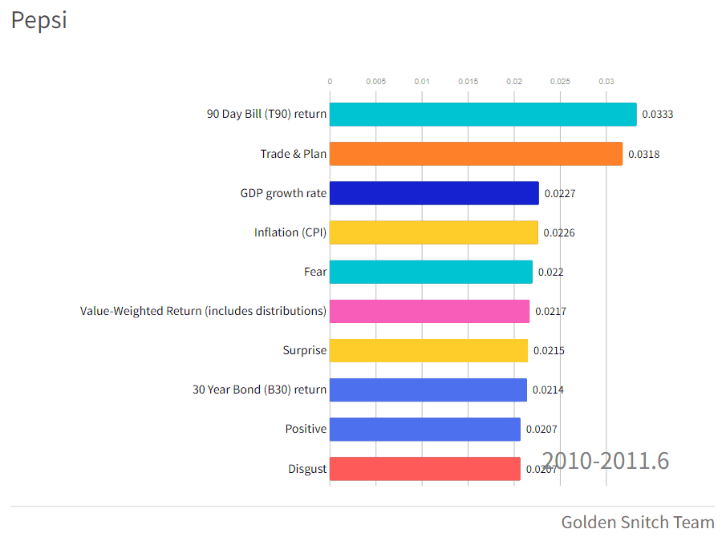

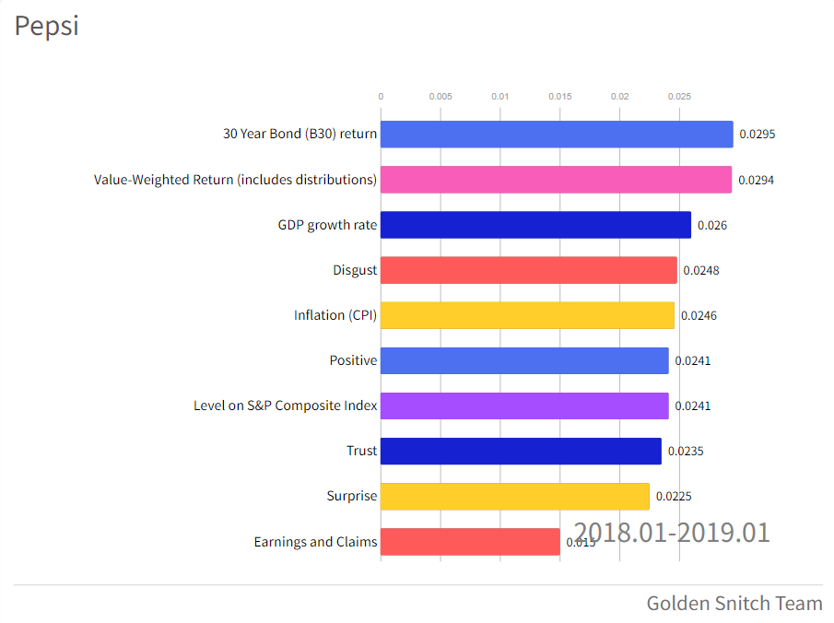
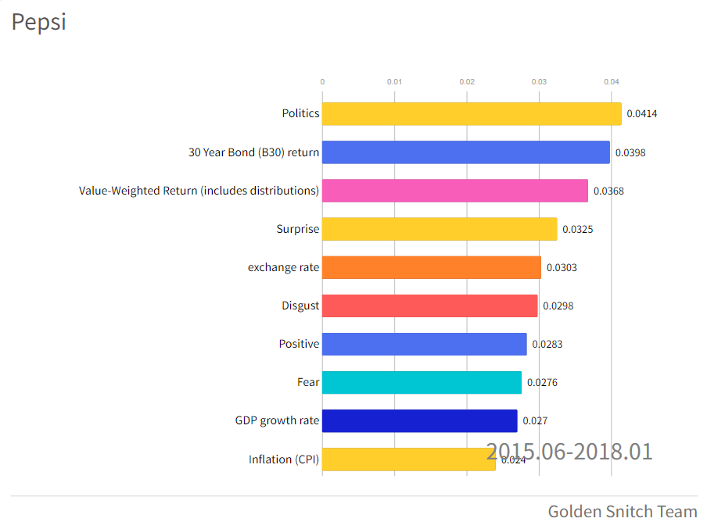
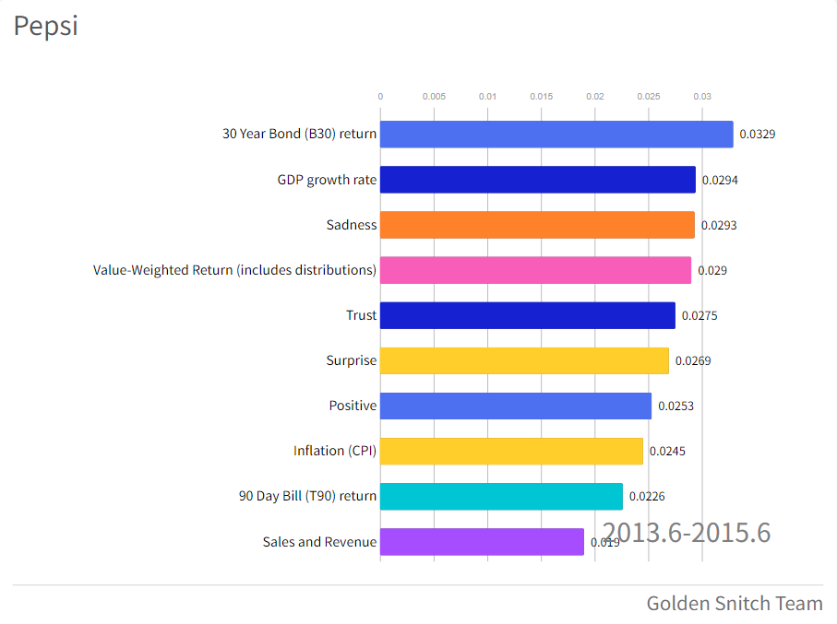
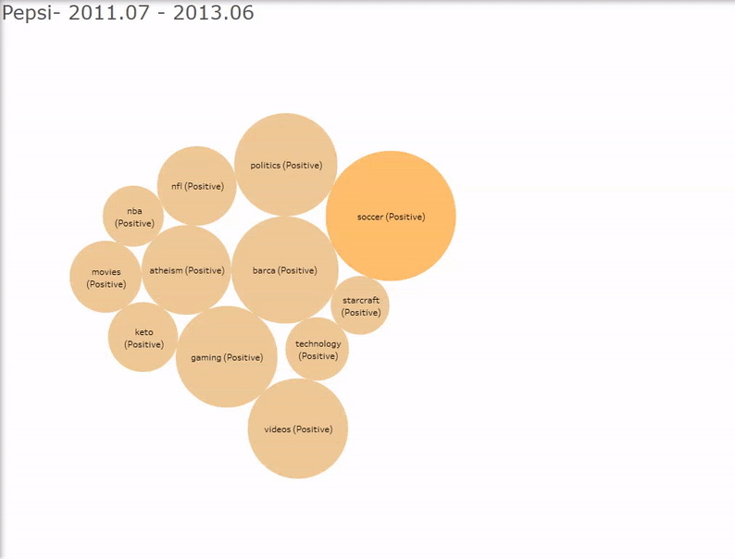
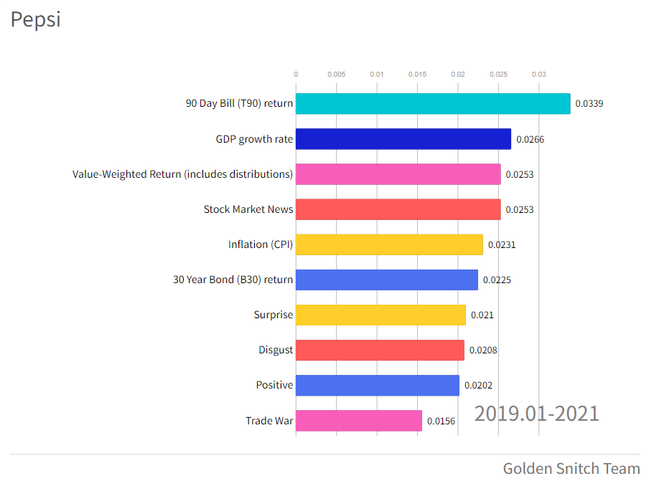
PepsiCo
Findings
Trade wars have great impacts on PepsiCo stock performance
Macroeconomics influences PepsiCo’s stock prices to a large extent of all time
Source: Reddit
PepsiCo

Slide 10


Recommendation
Model Robustness
Stock Evaluation
Incorporating both news and social media data makes the public sentiment and opinions less biased, thus ensuring the comprehensiveness and accuracy of model features
The usefulness of our model is reflected in giving investors potential warnings in the future by looking at the feature importances, which show highly correlated events that lead to significant stock return changes
e.g., American Airlines had related travel customer news in 2020, during the outbreak of Covid, giving the public hints
Investment function group should take into account of the public opinion when investigating the company’s performance
The customers’ relation information and the investors’ opinions can reflect the company image which is a valuable information for assessing the potential investment risk
Analysts can expand its reach through social medias like twitter and reddit
More customers and investors use this tools now
Social media can provide more in-time information compared to the traditional media channel
Recommendation

Slide 11
Appendix
Three Companies & SP 500 50 Day Moving Average Comparison
AAL: American Airlines
DIS: Disney
PEP: PepsiCo
Appendix

Slide 12
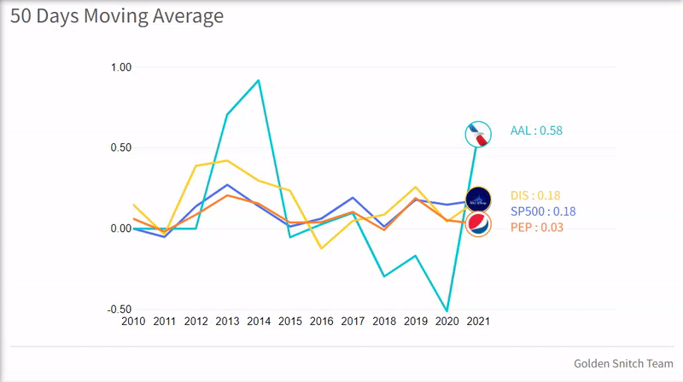
Appendix
Three Companies & SP 500 50 Day Moving Average Comparison
AAL: American Airlines
DIS: Disney
PEP: PepsiCo
Appendix

Slide 13
Appendix
Appendix - American Airlines Feature Importance 2013.12 - 2014.12

Slide 14
Appendix
Appendix - American Airlines Feature Importance 2015.01 - 2018.12

Slide 15
Appendix
Appendix - American Airlines Feature Importance 2019.01 - 2019.12

Slide 16
Appendix
Appendix - American Airlines Feature Importance 2020.01 - 2021.07

Slide 17
Appendix
Appendix - Disney Feature Importance 2010.01 - 2015.06

Slide 18
Appendix
Appendix - Disney Feature Importance 2015.06 - 2017.06

Slide 19
Appendix
Appendix - Disney Feature Importance 2017.06 - 2019.06

Slide 20
Appendix
Appendix - Disney Feature Importance 2019.06 - 2021.07

Slide 21
Appendix
Appendix - PepsiCo Feature Importance 2010.01 - 2011.06

Slide 22
Appendix
Appendix - PepsiCo Feature Importance 2011.06 - 2013.06

Slide 23
Appendix
Appendix - PepsiCo Feature Importance 2013.06 - 2015.06

Slide 24
Appendix
Appendix - PepsiCo Feature Importance 2015.06 - 2018.01

Slide 25
Appendix
Appendix - PepsiCo Feature Importance 2018.01 - 2019.01

Slide 26
Appendix
Appendix - PepsiCo Feature Importance 2019.01 - 2021.07

